Slide 1

Multivariate STATISTICS & econometrics

Slide 2

Case 1
On the morning of Feb 3, 2012, deputy general manager of Mahindra & Mahindra Ltd, Farm Division (MMFD), received a telephone call from a dealer. Dealer was complaining about the irregular and short supply of tractors from the company stockyard. He finally ended the call after assuring the dealer that he would get the problem resolved.

Slide 3
Company at a glance
Mahindra & Mahindra LTD was founded in 1945, it is a multinational company group worth of US$15.4 billion. MMFD provided tractors and agricultural equipment under ‘Mahindra Tractor’ brand name. It had four tractor manufacturing facilities in India, two in China, one in Australia and three in United States. It had been the largest tractor producer in India since 1983.

Slide 4
India tractors-market share (%) source- www.Mahindra.Com
Producers | FY09 | FY10 | FY11
Mahindra | 40.8 | 41.4 | 42.0
TAFE | 22.3 | 22.0 | 20.4
Escorts | 13.5 | 13.3 | 13.2
Sonalika | 8.9 | 8.7 | 8.6
FNH | 5.3 | 4.8 | 5.1
JD | 6.0 | 7.0 | 8.0
Others | 3.1 | 2.8 | 2.7

Slide 5
MMFD’s business model
MMFD had more than 800 dealers selling its tractors across India. The tractors were manufactured in one of the four plants located at Mumbai, Jaipur, Rudrapur and Nagpur and were then transported by road to one of the company’s stockyards, which were located in each state. MMFD had 26 sales offices located across India. Their main role is to coordinate between dealers and the company.

Slide 6
These sales offices provided a rolling tractor demand forecast for the current month plus two months in the future. This forecast was used to manufacture tractors and to enable placing parts supply orders in advance. The manufacturing plants supplied tractors to the stockyards as per the current monthly forecast. The tractor availability in the stockyards was the key concern given the demand from sellers according to the sales season. Demand for tractors followed a seasonal pattern; the peak seasons were, April through June and September through November.

Slide 7
The forecast & supply chain dilemma
Dealers were carrying tractor stock equal to 40 days of their annual sales, and an additional 20 days of stock were held at company stockyards. Thus, there were 60 days of finished goods waiting for customers, who were willing to wait for 5 to 15 days to receive a new tractor. The production of tractors was driven by material availability as well as changing customer demands.

Slide 8
Mr. Menon did not want to lose sales; therefore, to cater to market demand, he frequently did mid-month revisions in the forecast plan and inter-stockyard transfer of tractors in order to meet dealer demand (stockyard to stockyard transfers of tractors accounted for 6.7 per cent of the annual sales volume with an average transportation cost US$145 per tractor). But even then, dealers were often forced to sell alternate models at discounted prices to customers due to lack of availability of the desired model. This was the main reason for the high level of dealer dissatisfaction.

Slide 9
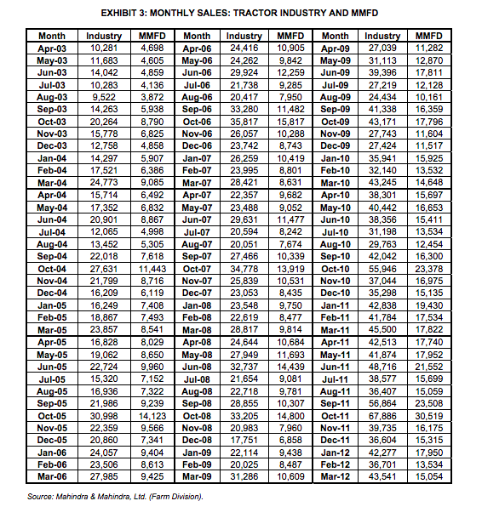
Available data 1

Slide 10
Available data 2
Tractor models | Industry | MMFD
Model 1 | 15,000 | 13,000
Model 2 | 20,000 | 22,000
Model 3 | 7,000 | 8,000

Slide 11
Available data 3
Sales | Seasons | Agr. Plot (total are) | PCI of rural population
12500 | Summer | 1010 | 8000
13900 | Winter | 2100 | 7600
11000 | Monsoon | 1300 | 6500
14120 | Monsoon | 1000 | 9000
12500 | Summer | 950 | 8200
15400 | Monsoon | 2200 | 9500
15000 | Winter | 2000 | 9000
14100 | Winter | 1190 | 6200
14500 | Summer | 1600 | 7000
15500 | Winter | 1900 | 9300

Slide 12
Mr. Menon finally ended the call after assuring the dealer that he would get the problem resolved.
How to help Mr. Menon using hypothesis testing

Slide 13
Research objective
Mr. Menon was concerned about the delivery delays. Therefore, he wanted to know whether the forecasting methodology was right. Forecasting depends on the available past data. He wanted to start with re-checking the data to examine the pattern again.

Slide 14
Research questions
1. He wanted to check whether the mean sales of two peak seasons across the nine years were same or significantly different.
2. He wanted to examine whether mean sales of a peak season and a lean season were actually significantly different or not.
3. He wanted to know whether there were any significant difference in the sales of peak seasons between last four years, 2008, 2009, 2010 and 2011.

Slide 15
Research questions
4. Is there any variation in sales of different model, if compared with MMFD and entire market?
5. What could be the factors influencing sales of tractors?
6. How to predict the sales for future months?

Slide 16
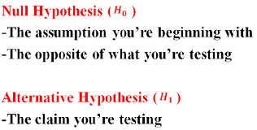

Slide 17
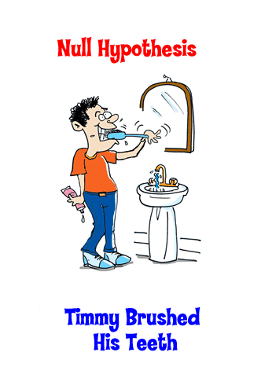


Slide 18


Slide 19


Slide 20


Slide 21
1st hypothesis
H₀: Mean sales of peak season 1 (April to June) = Mean sales of peak season 2 (September to November)
H₁: Mean sales of peak season 1 (April to June) ≠ Mean sales of peak season 2 (September to November)

Slide 22
2nd hypothesis
H₀ : Mean sales of peak season(April to June & September to November) = Mean sales of lean season(Rest of the months)
H₁ : Mean sales of peak season(April to June & September to November) > Mean sales of lean season(Rest of the months)

Slide 23
3rd hypothesis
H₀ : Mean sales of peak season (2008)=Mean sales of peak season (2009)=Mean sales of peak season (2010)=Mean sales of peak season (2011)
H₁ : Mean sales of peak season (2008)≠Mean sales of peak season (2009)≠Mean sales of peak season (2010)≠Mean sales of peak season (2011)

Slide 24
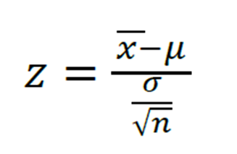
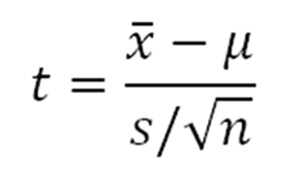
Which test for hypothesis 1? Test statistics for one sample case

Slide 25
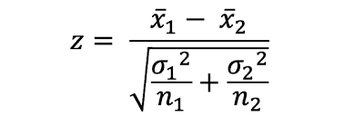
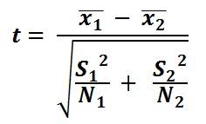
Which test for hypothesis 1? Test statistics for two sample case

Slide 26
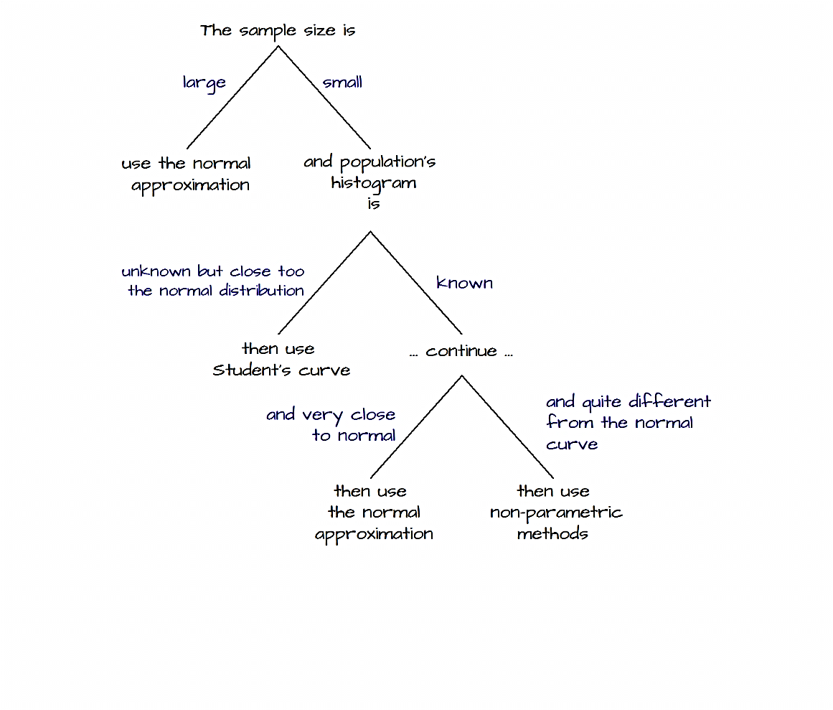
Decision

Slide 27
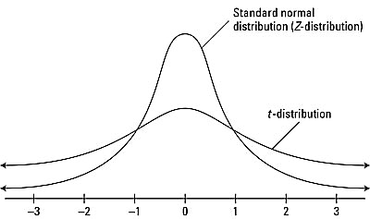

Slide 28
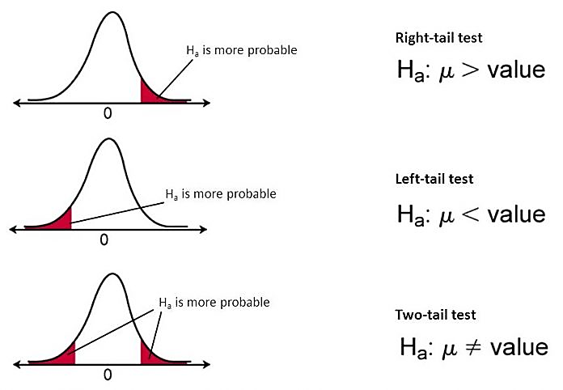
One and two tailed test

Slide 29
So, what is your decision?
Z or t test?
1 or 2 tailed test?

Slide 30
What is p-value
In statistics, the p-value is the probability of obtaining results as extreme as the observed results of a statistical hypothesis test, assuming that the null hypothesis is correct. The p-value is used as an alternative to rejection points to provide the smallest level of significance at which the null hypothesis would be rejected. A smaller p-value means that there is stronger evidence in favor of the alternative hypothesis.

Slide 31
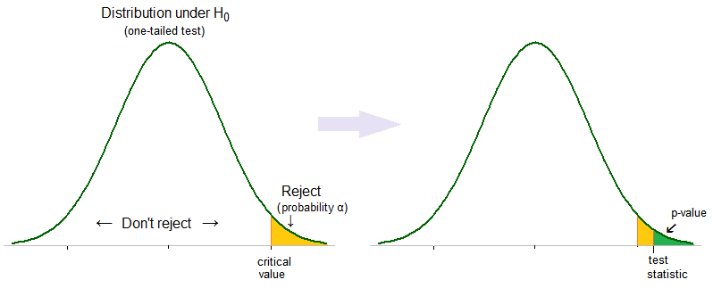
Acceptance or rejection of alternative hypothesis →p value

Slide 32
An example
A principal at a certain school claims that the students in his school are above average intelligence. A random sample of thirty students IQ scores have a mean score of 112.5. Is there sufficient evidence to support the principal’s claim? The mean population IQ is 100 with a standard deviation of 25.
Step 1: State the Null hypothesis. The accepted fact is that the population mean is 100, so: H0: μ<=100.
Step 2: State the Alternate Hypothesis. The claim is that the students have above average IQ scores, so:
H1: μ > 100.
The fact that we are looking for scores “greater than” a certain point means that this is a one-tailed test.
Step 3: Draw a picture to help you visualize the problem.

Slide 33
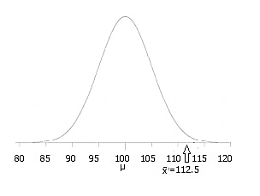

Slide 34
Step 4: State the alpha level. If you aren’t given an alpha level, use 5% (0.05).
Step 5: Find the rejection region area (given by your alpha level above) from the z-table. An area of .05 is equal to a z-score of 1.645.
Step 6: Find the test statistic using this formula: z score formula
For this set of data: z = (112.5-100) / (25/√30) = 2.74.
Step 6: If Step 6 is greater than Step 5, reject the null hypothesis. If it’s less than Step 5, you cannot reject the null hypothesis. In this case, it is greater (2.74 > 1.645), so you can reject the null.

Slide 35
How to modify this with p value?

Slide 36


For a right tail test
P<= $α$
Reject the null hypothesis
P >$α$
Cannot reject the null hypothesis

Slide 37
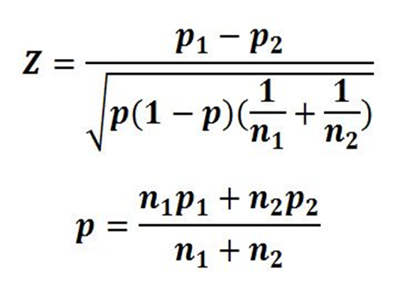
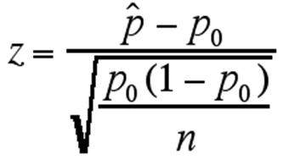
Test statistics for proportions

Slide 38
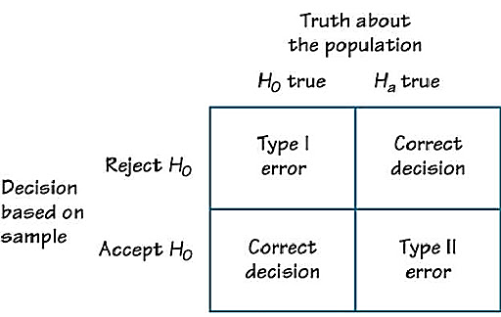
Type I & type II error

Slide 39
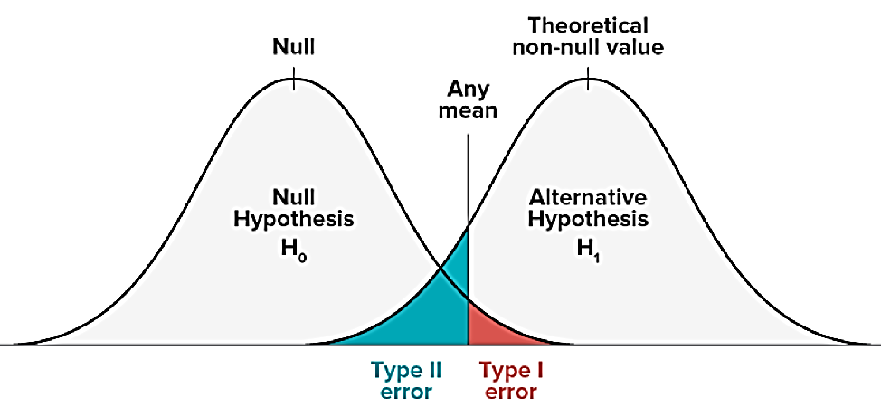
Calculate type I and type II error

Slide 40
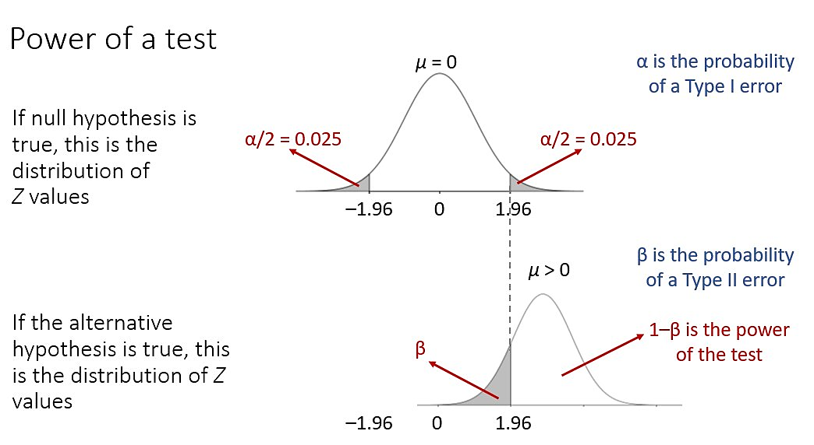
Power of a test

Slide 41
Suppose we are about to sample 36 values from a normally distributed population, where δ = 21 but µ is unknown. We are going to test:
H0: µ=50
H1: µ<50
α = .09
For what value of Z will we reject H0?

Slide 42
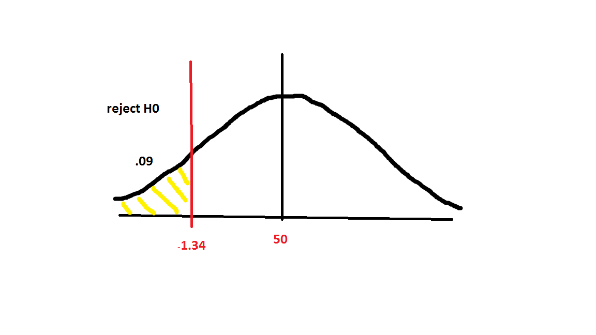

Slide 43
Calculate x bar from this equation with the other known values.
µ = 50
δ= 21
N= 36
Z= -1.34
X bar = 45.31

Slide 44
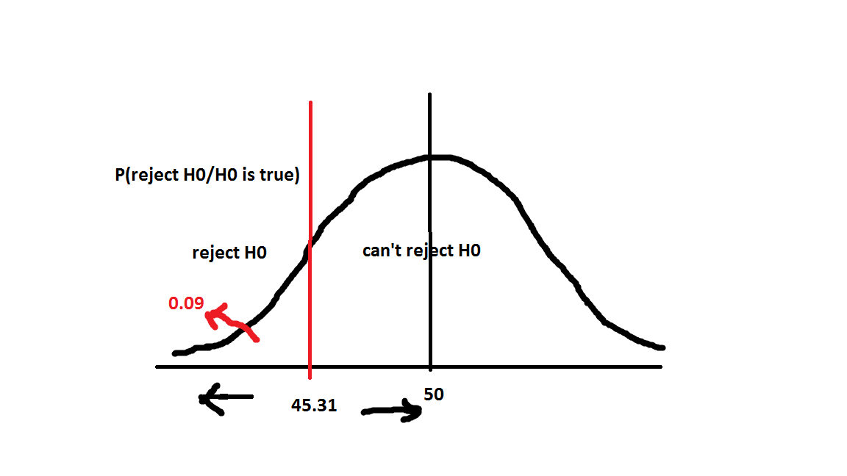
Type I error

Slide 45
If the true value of µ= 43, what is the probability of type II error?
H0: µ=50
H1: µ<50
Probability (do not reject H0 / µ=43)
We reject H0 if, X bar ≤ 45.31
Therefore, prob of type II error is,
=P (X bar > 45.31/ µ= 43)

Slide 46
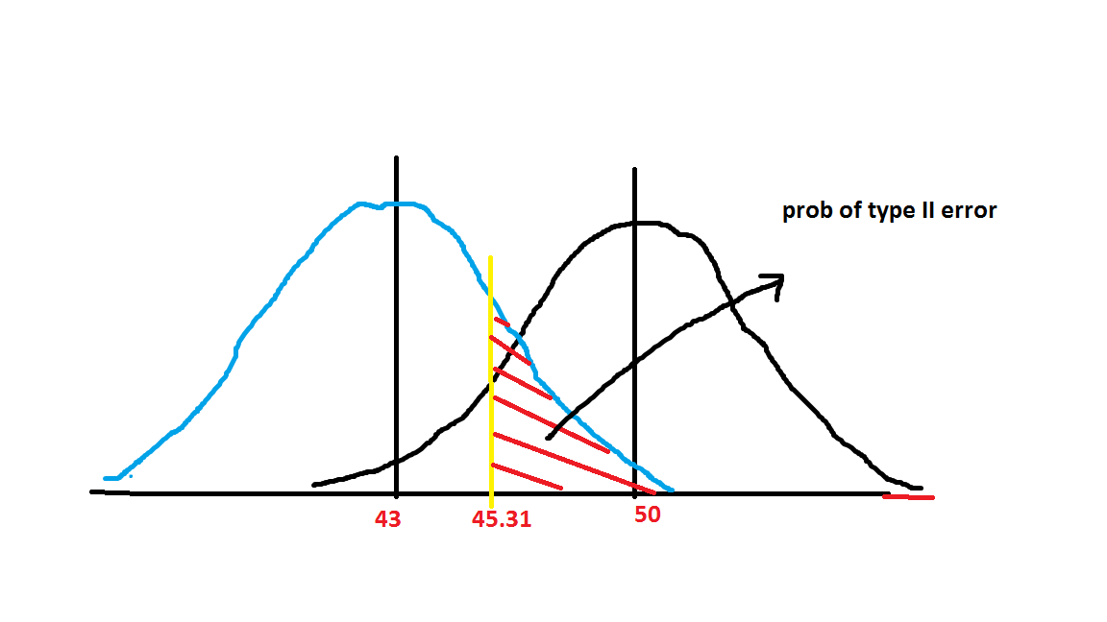

Slide 47

Z= $\frac{45.31−43}{21/√36}$
= 0.66
Therefore,
P (type II error) = P (Z > 0.66)
= 0.255

Slide 48
Power of a test
= 1 – probability of type II error
= 1 – 0,255
= 0.745

Slide 49
Which test for hypothesis 2?

Slide 50
Which test for hypothesis 3?

Slide 51
We cannot use Z or t test for hypothesis 3.
As these two tests can only be used to compare two means or two proportions.
Therefore, here we need to use F test.

Slide 52
F test
F-tests are named after its test statistic, F, which was named in honor of Sir Ronald Fisher. The F-statistic is simply a ratio of two variances. Variances are a measure of dispersion, or how far the data are scattered from the mean. Larger values represent greater dispersion.
Then why is the method comparing several means the 'analysis of variance', rather than 'analysis of means' themselves?
It is because that the relative location of the several group means can be more conveniently identified by variance among the group means than comparing many group means directly when number of means are large.

Slide 53
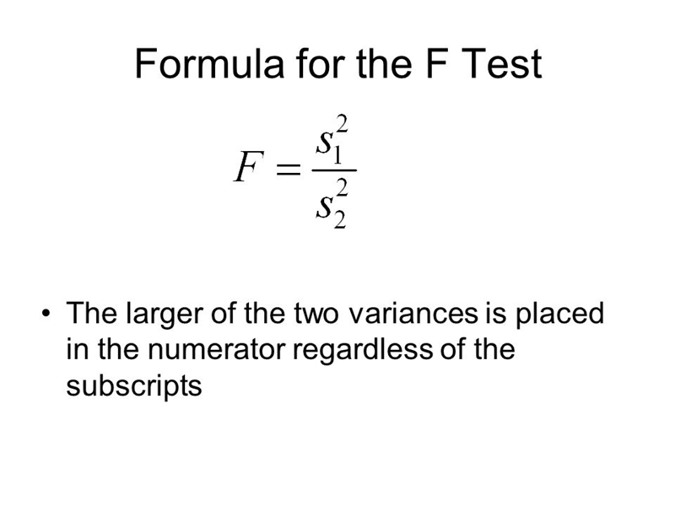
F test

Slide 54
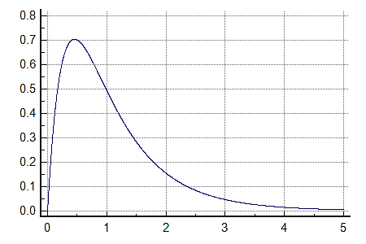
F distribution

Slide 55
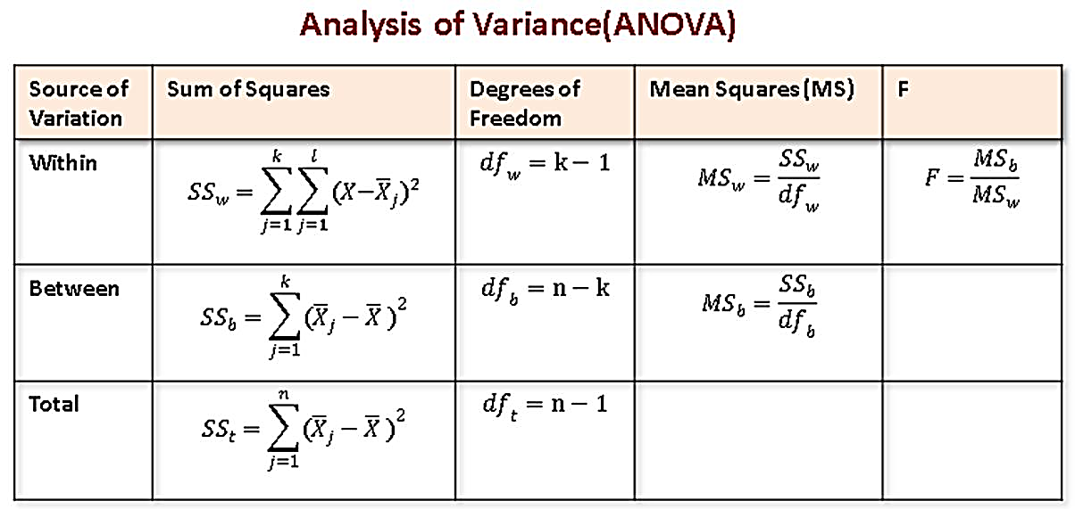
ANOVA

Slide 56
ANOVA example
The data below resulted from measuring the difference in resistance resulting from subjecting identical resistors to three different temperatures for a period of 24 hours. The sample size of each group was 5. In the language of design of experiments, we have an experiment in which each of three treatments was replicated 5 times.

Slide 57
The table
 | Level 1 | Level 2 | Level 3
 | 6.9 | 8.3 | 8.0
 | 5.4 | 6.8 | 10.5
 | 5.8 | 7.8 | 8.1
 | 4.6 | 9.2 | 6.9
 | 4.0 | 6.5 | 9.3
means | 5.34 | 7.72 | 8.56

Slide 58
STEP 1
Compute CM, the correction for the mean.
CM=(Total of all observations)²/N
total=(108.1)²/15=779.041
Step 2:
Compute SST
= sum of squares of all observations −CM.
=SS(Total)=(6.9)²+(5.4)²+…+(6.9)²+(9.3)²−CM
=829.390−779.041=45.439
The value of 829.390 is called the "raw" or "uncorrected " sum of squares.

Slide 59
STEP 3
Compute SSB,.
First we compute the total (sum) for each treatment.
T1=6.9+5.4+…+4.0=26.7
T2=8.3+6.8+…+6.5=38.6
T3=8.0+10.5+…+9.3=42.8
Then,
SSB=(26.7)²/5+(38.6)²/5+(42.8)²/5−779.041=27.897.
STEP 4
Compute SSE, the error sum of squares. Here we utilize the property that the treatment sum of squares plus the error sum of squares equals the total sum of squares. Hence,
SSE=SST−SSB=45.349−27.897=17.45.

Slide 60
The resulting ANOVA table is
Source SS DF MS F
between 27.897 2 13.949 9.59
within 17.452 12 1.454

Slide 61
Decision
The test statistic is the F value of 9.59.
Using an α of 0.05, we have F[0.05; 2,12] = 3.89.
Since the test statistic is much larger than the critical value, we reject the null hypothesis of equal population means and conclude that there is a (statistically) significant difference among the population means.

Slide 62
Answer to research question 4
Is there any variation in sales of different model, if compared with MMFD and entire market?
(Available data 2)

Slide 63
Chi square distribution
A chi-square distribution is a continuous distribution with k degrees of freedom. It is used to describe the distribution of a sum of squared random variables. It is also used to test the goodness of fit of a distribution of data, whether data series are independent, and for estimating confidences surrounding variance and standard deviation for a random variable from a normal distribution.

Slide 64
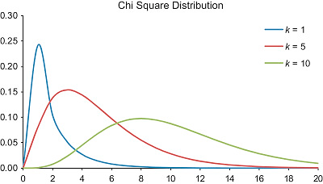

Slide 65
What is a chi square test?
There are two types of chi-square tests. Both use the chi-square statistic and distribution for different purposes:
A chi-square goodness of fit test determines if a sample data matches a population.
A chi-square test for independence compares two variables in a contingency table to see if they are related. In a more general sense, it tests to see whether distributions of categorical variables differ from each another.

Slide 66
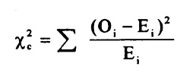
What is a chi-square statistic?
The formula for the chi-square statistic used in the chi square test is:
The subscript “c” are the degrees of freedom. “O” is your observed value and E is your expected value.

Slide 67
A low value for chi-square means there is a high correlation between your two sets of data. In theory, if your observed and expected values were equal (“no difference”) then chi-square would be zero — an event that is unlikely to happen in real life.

Slide 68
Null Hypothesis: The two categorical variables are independent
Alternative Hypothesis: The two categorical variables are dependent
Chi-Square Test Statistic: χ²=∑(O−E)² / E, where O represents the observed frequency. E is the expected frequency under the null hypothesis and computed by:
E= (row total × column total) / sample size
We will compare the value of the test statistic to the critical value of χ_{α}² with degree of freedom = (r - 1) (c - 1), and reject the null hypothesis if χ² > χ_{α}².

Slide 69
Is gender independent of education level? A random sample of 395 people were surveyed and each person was asked to report the highest education level they obtained. The data that resulted from the survey is summarized in the following table:
Question: Are gender and education level dependent at 5% level of significance? In other words, given the data collected above, is there a relationship between the gender of an individual and the level of education that they have obtained?
Answer

Slide 71
Here's the table of expected counts:
 | High School | Bachelors | Masters | Ph.D. | Total
Female | 50.886 | 49.868 | 50.377 | 49.868 | 201
Male | 49.114 | 48.132 | 48.623 | 48.132 | 194
Total | 100 | 98 | 99 | 98 | 395

Slide 72
So, working this out,
χ²=(60−50.886) ² / 50.886+⋯+(57−48.132) ² / 48.132
= 8.006
The critical value of χ² with 3 degree of freedom is 7.815. Since 8.006 > 7.815, we reject the null hypothesis and conclude that the education level depends on gender at a 5% level of significance.

Slide 73
Example: "Which holiday do you prefer?“
Beach Cruise
Men 209 280
Women 225 248
Does Gender affect Preferred Holiday?
If Gender (Man or Woman) does affect Preferred Holiday we say they are dependent.

Slide 74
In a prior example we evaluated data from a survey of university graduates which assessed, among other things, how frequently they exercised. The survey was completed by 470 graduates. In the prior example we used the χ² goodness-of-fit test to assess whether there was a shift in the distribution of responses to the exercise question following the implementation of a health promotion campaign on campus. We specifically considered one sample (all students) and compared the observed distribution to the distribution of responses the prior year (a historical control). Suppose we now wish to assess whether there is a relationship between exercise on campus and students' living arrangements. As part of the same survey, graduates were asked where they lived their senior year. The response options were dormitory, on-campus apartment, off-campus apartment, and at home (i.e., commuted to and from the university). The data are shown below.

Slide 76
Based on the data, is there a relationship between exercise and student's living arrangement? Do you think where a person lives affect their exercise status? Here we have four independent comparison groups (living arrangement) and a discrete (ordinal) outcome variable with three response options. We specifically want to test whether living arrangement and exercise are independent!

Slide 77
Pancreaticoduodenectomy (PD) is a procedure that is associated with considerable morbidity. A study was recently conducted on 553 patients who had a successful PD between January 2000 and December 2010 to determine whether their Surgical Apgar Score (SAS) is related to 30-day perioperative morbidity and mortality. The table below gives the number of patients experiencing no, minor, or major morbidity by SAS category.
Question: What would be an appropriate statistical test to examine whether there is an association between Surgical Apgar Score and patient outcome? Using 14.13 as the value of the test statistic for these data, carry out the appropriate test at a 5% level of significance.

Slide 79
Answer to research question 5
What could be the factors influencing sales of tractors?
(Available data 3)

Slide 80
Multiple regression
It is an extension of simple linear regression. It is used when we want to predict the value of a variable based on the value of two or more other variables. The variable we want to predict is called the dependent variable (or sometimes, the outcome, target or criterion variable).

Slide 81
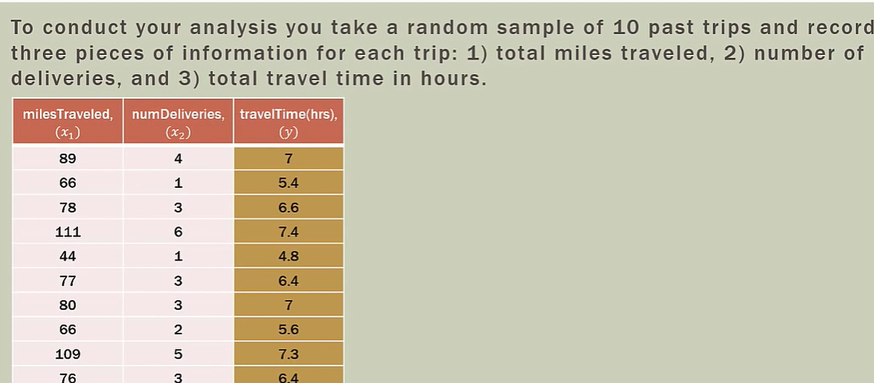
Example

Slide 82
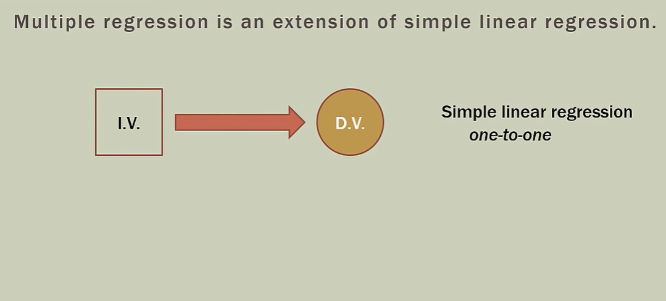
Simple relationship

Slide 83
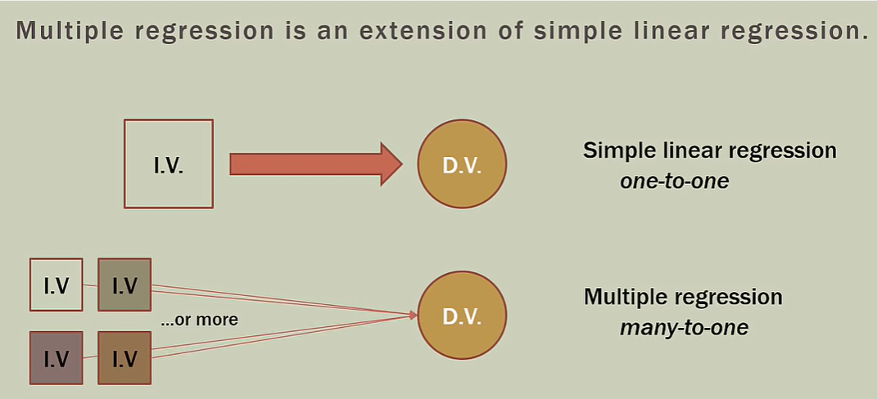
Multiple relationship

Slide 84
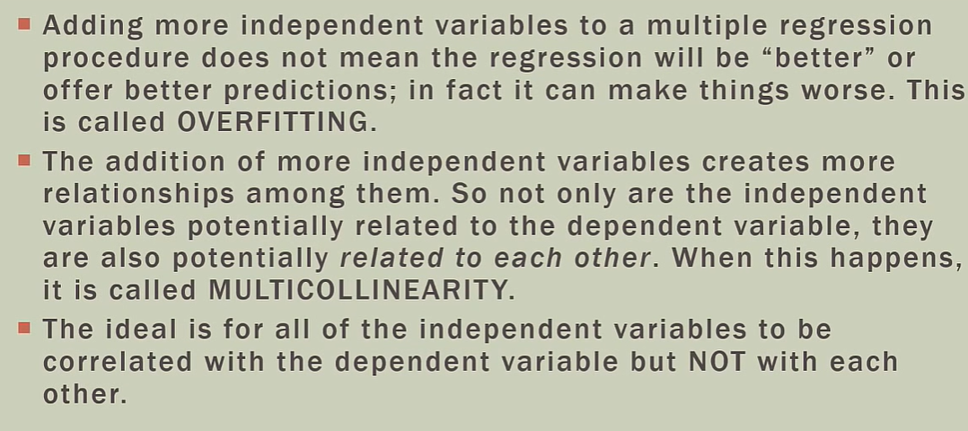
Problems to start

Slide 85
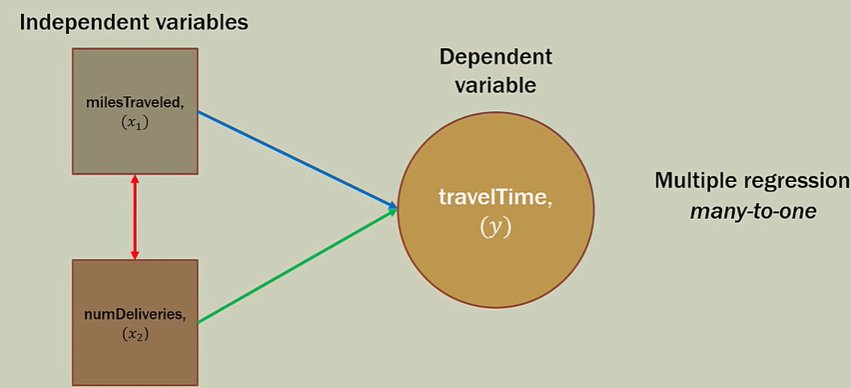
Multicollinearity

Slide 86
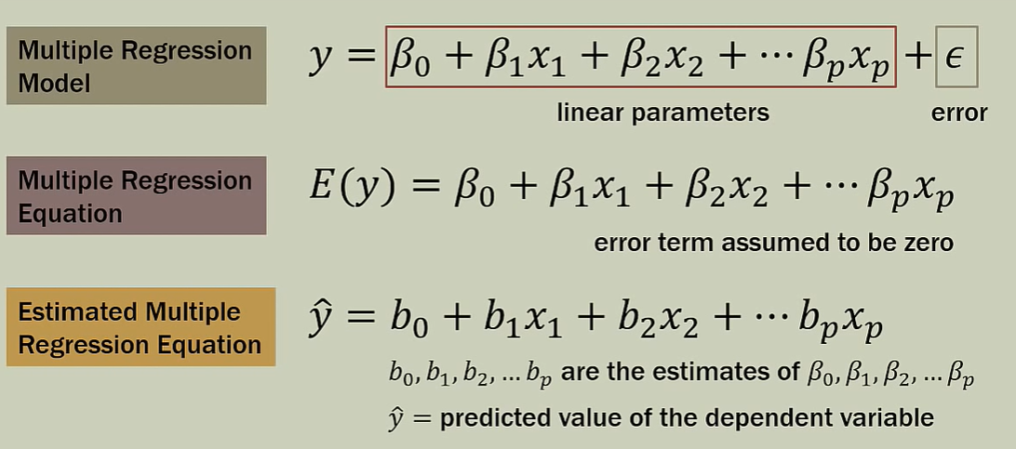
Equations

Slide 87
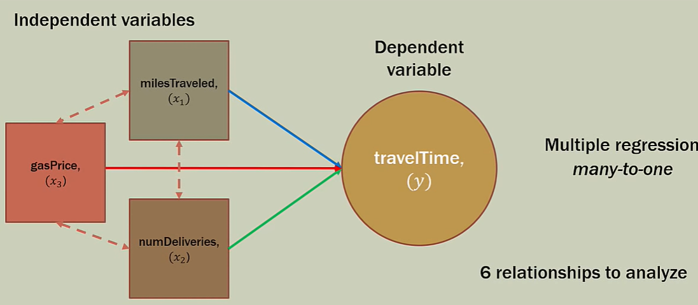
Multicollinearity

Slide 88
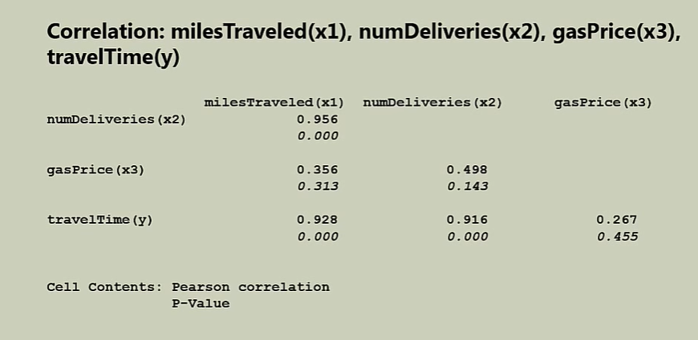
Correlation results

Slide 89
The potential solutions include the following:
Remove some of the highly correlated independent variables.
Linearly combine the independent variables, such as adding them together.
Perform an analysis designed for highly correlated variables, such as principal components analysis or partial least squares regression.

Slide 90
The goodness of fit test is a statistical hypothesis test to see how well sample data fit a distribution from a population with a normal distribution. Put differently, this test shows if your sample data represents the data you would expect to find in the actual population or if it is somehow skewed.

Slide 91
R-squared is a statistical measure of how close the data are to the fitted regression line. It is also known as the coefficient of determination, or the coefficient of multiple determination for multiple regression. 0% indicates that the model explains none of the variability of the response data around its mean.

Slide 92
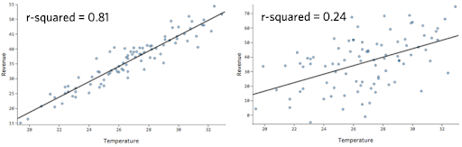

Slide 93
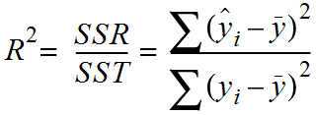
R squared

Slide 94
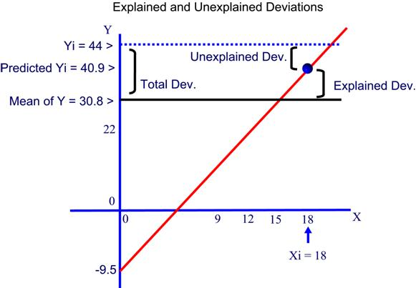

Slide 95
R-squared has limitations
You cannot use R-squared to determine whether the coefficient estimates and predictions are biased, which is why you must assess the residual plots.
R-squared does not indicate if a regression model provides an adequate fit to your data. A good model can have a low R² value. On the other hand, a biased model can have a high R² value!

Slide 96
Are low r-squared values always a problem?
No! Regression models with low R-squared values can be perfectly good models for several reasons.
Some fields of study have an inherently greater amount of unexplainable variation. In these areas, your R² values are bound to be lower. For example, studies that try to explain human behavior generally have R² values less than 50%. People are just harder to predict than things like physical processes.

Slide 97
There is a scenario where small R-squared values can cause problems. If you need to generate predictions that are relatively precise (narrow prediction intervals), a low R² can be a show stopper.

Slide 98
R-squared and understanding the relationships between the variables
If your primary goal is to understand the relationships between the variables in your model, the answer to how high R-squared needs to be is very simple. For this objective, R² is irrelevant.
Suppose we have a statistically significant coefficient that equals 2. This coefficient indicates that the mean of the dependent variable increases by 2 for every one-unit increase in the independent variable irrespective of the R² value.

Slide 99
R-squared and predicting the dependent variable
R² is relevant in this context because it is a measure of the error. Lower R² values correspond to models with more error, which in turn produces predictions that are less precise. In other words, if your R² is too low, your predictions will be too imprecise to be useful.

Slide 100
R-squared does have some good uses. For one thing, compare your R² value to values from similar studies. If your R² is markedly higher or lower, you should investigate because there might be a problem.

Slide 101
Some problems with r-squared
Problem 1: Every time you add a predictor to a model, the R-squared increases, even if due to chance alone. It never decreases. Consequently, a model with more terms may appear to have a better fit simply because it has more terms.
Problem 2: If a model has too many predictors and higher order polynomials, it begins to model the random noise in the data. This condition is known as over-fitting the model and it produces misleadingly high R-squared values and a lessened ability to make predictions.

Slide 102
What are the other options?

Slide 103
Adjusted R-squared
The adjusted R-squared is a modified version of R-squared that has been adjusted for the number of predictors in the model. The adjusted R-squared increases only if the new term improves the model more than would be expected by chance. It decreases when a predictor improves the model by less than expected by chance.

Slide 104
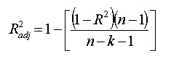
The adjusted R² is smaller than the ordinary R² whenever the number of parameters (K) is greater than 1.

Slide 105
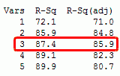
R squared & adj. R squared

Slide 106
The predicted R-squared indicates how well a regression model predicts responses for new observations. This statistic helps you determine when the model fits the original data but is less capable of providing valid predictions for new observations

Slide 107
Statistical software calculates predicted R-squared using the following procedure
It removes a data point from the dataset.
Calculates the regression equation.
Evaluates how well the model predicts the missing observation.
And, repeats this for all data points in the dataset.

Slide 108
Predicted R-squared
Predicted R-squared is a measure of how well the model predicts a response value. It is computed as:
Pred.R²=1−[PRESS/(SS residual + SS model)]
The Adjusted R-squared and Predicted R-squared should be within approximately 0.20 of each other to be in “reasonable agreement.” If they are not, there may be a problem with either the data or the model.

Slide 109
The Predicted Residual Sum of Squares for the model. A measure of how well a particular model fits each point in the design. The coefficients for a new model are calculated with one point “deleted”. The new model’s prediction is subtracted from the “deleted” observation to find the predicted residual. This is done for each data point. The predicted residuals are squared and added together to form the PRESS.
PRESS= ∑(e_{−i})²
e_{−i} is a deletion residual computed by fitting a model without the ith run then predicting the ith observation with the resulting model.

Slide 110
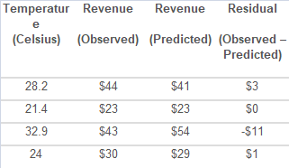
Residual plot

Slide 111
Residual plot & goodness of fit
Check that they are randomly scattered around zero for the entire range of fitted values. When the residuals center on zero, they indicate that the model’s predictions are correct on average rather than systematically too high or low.

Slide 112
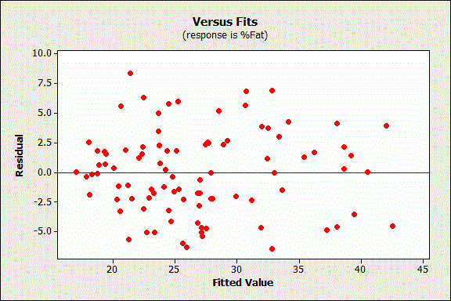
Correct residual plot

Slide 113
Standard error of estimate
Definition: The Standard Error of Estimate is the measure of variation of an observation made around the computed regression line. Simply, it is used to check the accuracy of predictions made with the regression line.

Slide 114
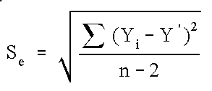
The reason N-2 is used rather than N-1 is that two parameters (the slope and the intercept) were estimated.

Slide 115
Standard error of estimate
The smaller the value of a standard error of estimate the closer are the dots to the regression line and better is the estimate based on the equation of the line. If the standard error is zero, then there is no variation corresponding to the computed line and the correlation will be perfect.

Slide 116
The regression equation in matrix form
With multiple regression, there is one dependent variable and k independent variables. The regression equation is:
ŷ = b₀ + b₁x₁ + b₂x₂ + … + b_{k-1}x_{k-1} + b_{k}x_{k}
where ŷ is the predicted value of the dependent variable, b_{k} are regression coefficients, and x_{k} is the value of independent variable k.
To express the regression equation in matrix form, we need to define three matrices: Y, b, and X.

Slide 117
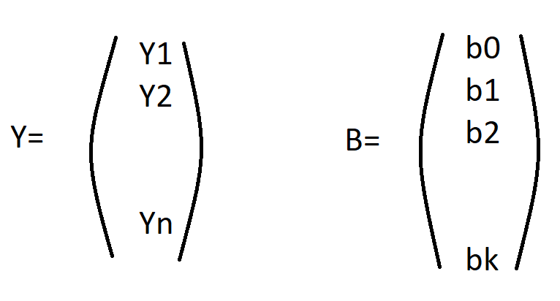

Slide 118
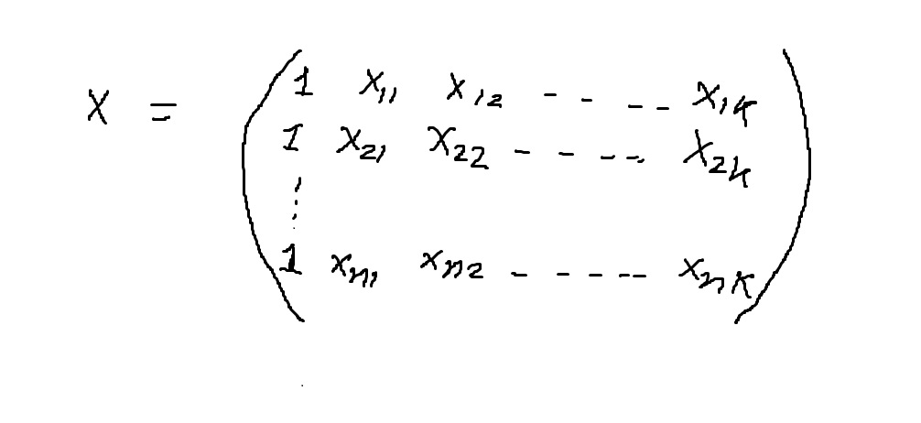

Slide 119
Here, the dataset consists of n records. Each record includes scores for 1 dependent variable and k independent variables. Y is an n x 1 vector that holds predicted values of the dependent variable; and b is a k + 1 x 1 vector that holds estimated regression coefficients. Matrix X has a column of 1's plus k columns of values for each independent variable in the regression equation.
Given these matrices, the multiple regression equation can be expressed concisely as:
Y = Xb

Slide 120
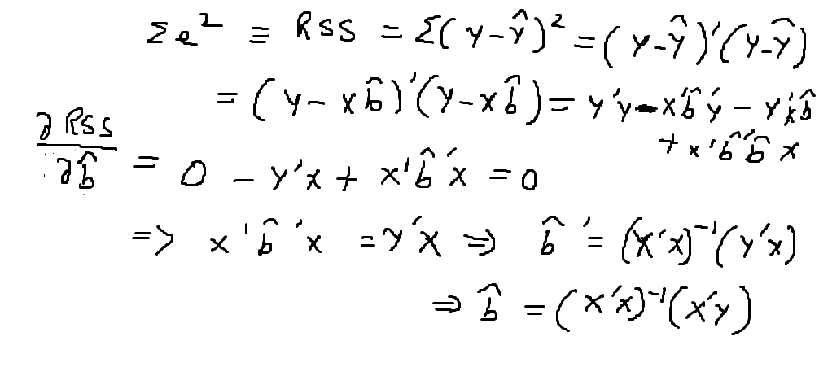

Slide 121
Consider the table below. It shows three performance measures for five students

Slide 122
For this problem, we have some raw data; and we want to use this raw data to define a least-squares regression equation:
ŷ = b₀ + b₁x₁ + b₂x₂
where ŷ is the predicted test score; b₀, b₁, and b₂ are regression coefficients; x₁ is an IQ score; and x₂ is the number of hours that the student studied.
On the right side of the equation, the only unknowns are the regression coefficients. To define the regression coefficients, we use the following equation:
b = (X'X)⁻¹X'Y

Slide 123
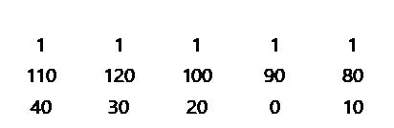
Let's begin with matrix X. Matrix X has a column of 1's plus two columns of values for each independent variable. So, this is matrix X and its transpose X':
X’ =
X=

Slide 124
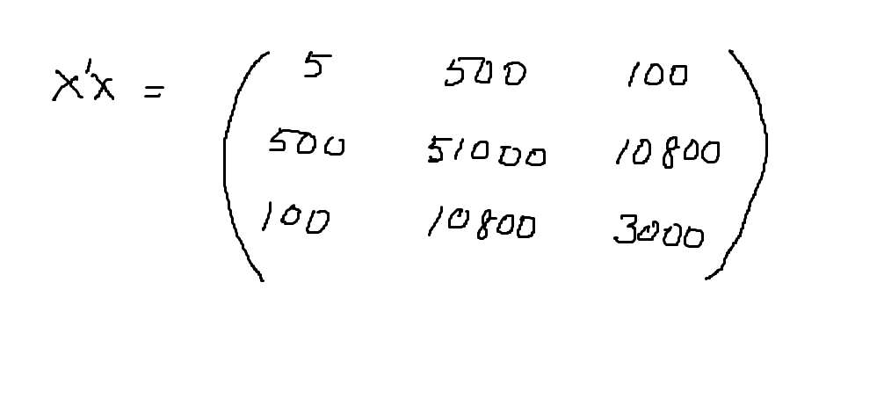

Slide 125
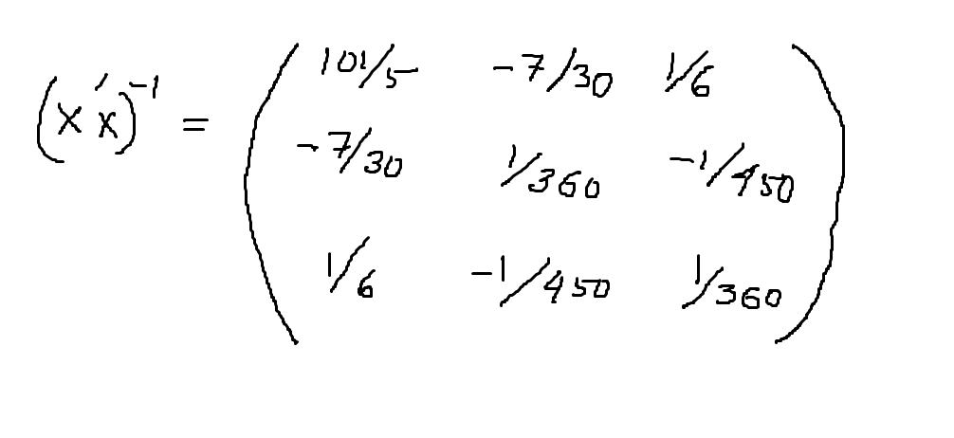

Slide 126
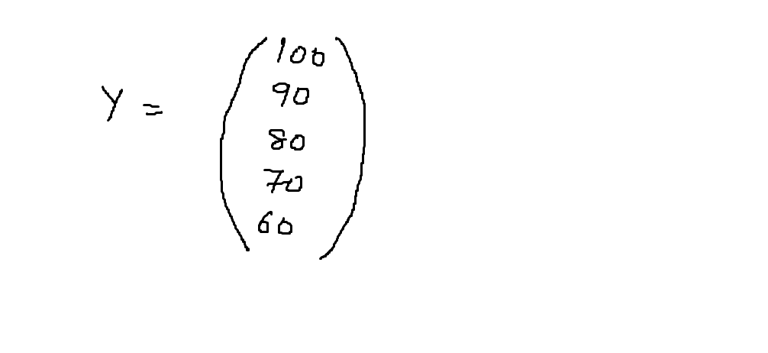

Slide 127
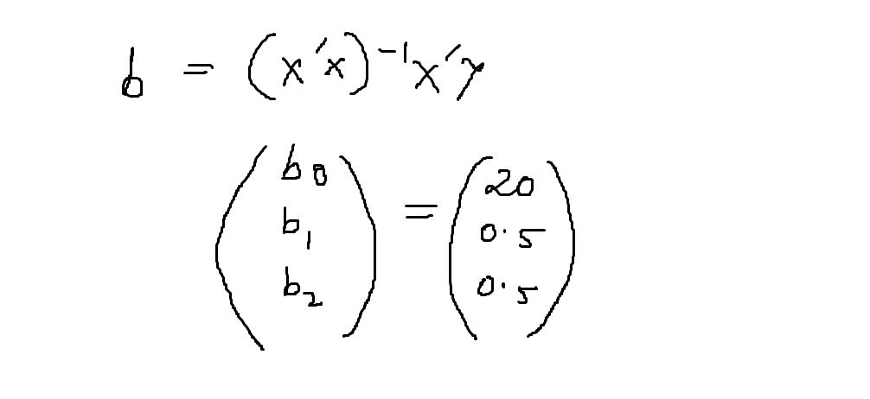

Slide 128
To conclude, here is our least-squares regression equation:
ŷ = 20 + 0.5x₁ +0.5x₂
where ŷ is the predicted test score; x₁ is an IQ score; and x₂ is the number of hours that the student studied. The regression coefficients are b₀ = 20, b₁ = 0.5, and b₂ = 0.5.

Slide 129
Multiple regression and hypothesis testing

Slide 130


Slide 131
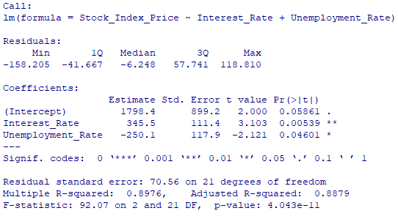
Regression output, R

Slide 132


Slide 133


Slide 134


Slide 135

Regression output, excel

Slide 136
Interpretation
Multiple R. This is the correlation coefficient. It tells you how strong the linear relationship is. For example, a value of 1 means a perfect positive relationship and a value of zero means no relationship at all. It is the square root of r squared
R squared. This is r², the Coefficient of Determination. It tells you how many points fall on the regression line. for example, 80% means that 80% of the variation of y-values around the mean are explained by the x-values. In other words, 80% of the values fit the model.
Adjusted R square. The adjusted R-square adjusts for the number of terms in a model. You’ll want to use this instead of #2 if you have more than one x variable.
Standard Error of the regression: An estimate of the standard deviation of the error μ. This is not the same as the standard error in descriptive statistics! The standard error of the regression is the precision that the regression coefficient is measured; if the coefficient is large compared to the standard error, then the coefficient is probably different from 0.
Observations. Number of observations in the sample.

Slide 137

Regression output, python

Slide 138
Log-likelihood function
The log-likelihood function is typically used to derive the maximum likelihood estimator of the parameter . The estimator is obtained by solving that is, by finding the parameter that maximizes the log-likelihood of the observed sample .

Slide 139
Akaike information criterion
This criterion, referred to as the Akaike information criterion (AIC), is generally considered the first model selection criterion that should be used in practice. The AIC is
AIC= -2log L(θ ˆ )+ 2k
where θ = the set (vector) of model parameters L(θˆ) = the likelihood of the model given the data when evaluated at the maximum likelihood estimate of θ
K= the number of estimated parameters in the model

Slide 140
Bayesian information criterion
The BIC is computed as follows:
BIC = -2logL(θˆ) + k log n
where the terms above are the same as described in our description of the AIC

Slide 141
Omnibus/ Prob (Omnibus) – a test of the skewness and kurtosis of the residual (characteristic #2). We hope to see a value close to zero which would indicate normalcy. The Prob (Omnibus) performs a statistical test indicating the probability that the residuals are normally distributed. We hope to see something close to 1 here. In this case Omnibus is relatively low and the Prob (Omnibus) is relatively high so the data is somewhat normal, but not altogether ideal. A linear regression approach would probably be better than random guessing but likely not as good as a nonlinear approach.

Slide 142
Skew – a measure of data symmetry. We want to see something close to zero, indicating the residual distribution is normal. Note that this value also drives the Omnibus. This result has a small, and therefore good, skew.
Kurtosis – a measure of "peak", or curvature of the data. Higher peaks lead to greater Kurtosis. Greater Kurtosis can be interpreted as a tighter clustering of residuals around zero, implying a better model with few outliers.
Durbin-Watson – tests for autocorrelation. We hope to have a value between 1 and 2. In this case, it is closed.
Jarque-Bera (JB)/Prob(JB) – like the Omnibus test in that it tests both skew and kurtosis. We hope to see in this test a confirmation of the Omnibus test. In this case we do.

Slide 143
What is the jarque-bera test?
The Jarque-Bera Test, is a test for normality. Normality is one of the assumptions for many statistical tests, like the t test or F test; the Jarque-Bera test is usually run before one of these tests to confirm normality. It is usually used for large data sets.
Specifically, the test matches the skewness and kurtosis of data to see if it matches a normal distribution. The data could take many forms, including:
Time Series Data.
Errors in a regression model.

Slide 144
Running the test
JB = n [(√b₁)² / 6 + (b₂ – 3)² / 24].
Where: n is the sample size, √b₁ is the sample skewness coefficient, b₂ is the kurtosis coefficient.
The null hypothesis for the test is that the data is normally distributed; the alternate hypothesis is that the data does not come from a normal distribution.

Slide 145
Interpretation
In general, a large J-B value indicates that errors are not normally distributed.
A result of 1 means that the null hypothesis has been rejected at the 5% significance level. In other words, the data does not come from a normal distribution. A value of 0 indicates the data is normally distributed.

Slide 146
Condition number
This test measures the sensitivity of a function's output as compared to its input. When we have multicollinearity, we can expect much higher fluctuations to small changes in the data, hence, we hope to see a relatively small number, something below 30.

Slide 147
Dummy variables in regression

Slide 148
What is a dummy variable?
A dummy variable is a numeric variable that represents categorical data, such as gender, race, political affiliation, etc.
Technically, dummy variables are dichotomous, quantitative variables. Their range of values is small; they can take on only two quantitative values. As a practical matter, regression results are easiest to interpret when dummy variables are limited to two specific values, 1 or 0. Typically, 1 represents the presence of a qualitative attribute, and 0 represents the absence.

Slide 149
How many dummy variables?
The number of dummy variables required to represent a particular categorical variable depends on the number of values that the categorical variable can assume. To represent a categorical variable that can assume k different values, a researcher would need to define k - 1 dummy variables.
For example, suppose we are interested in political affiliation, a categorical variable that might assume three values - Republican, Democrat, or Independent. We could represent political affiliation with two dummy variables:
X₁ = 1, if Republican; X₁ = 0, otherwise.
X₂ = 1, if Democrat; X₂ = 0, otherwise.

Slide 150
Avoid the dummy variable trap
A k^{th} dummy variable is redundant; it carries no new information. And it creates a severe multicollinearity problem for the analysis. Using k dummy variables when only k - 1 dummy variables are required is known as the dummy variable trap. Avoid this trap!

Slide 151
Answer to research question 6
How to predict the sales for future months?
(Available data 1)

Slide 152
Time series analysis – trend, moving average and forecasting

Slide 153


Slide 154

Components of time series

Slide 155
Classical multiplicative model
Y_{t}= T_{t} X C_{t} X S_{t} X I_{t}

Slide 156
Let us use Excel to forecast the demand

Slide 157
Original data and calculation

Slide 158

Original plot

Slide 159
Regression output to find trend

Slide 160

Forecasted plot

Slide 161
Conclusion
All of these statistical methods can help us to answer each of those six research questions.
By which, Mr Menon can identify the problems and solve them.

